Slide 1








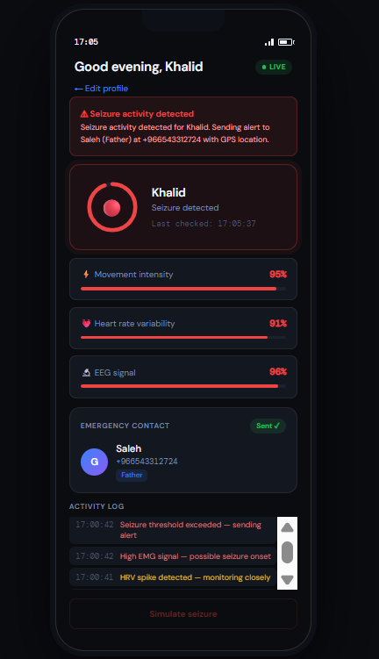

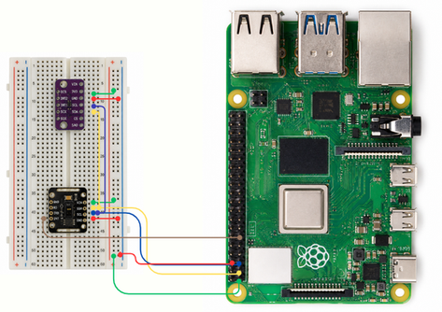




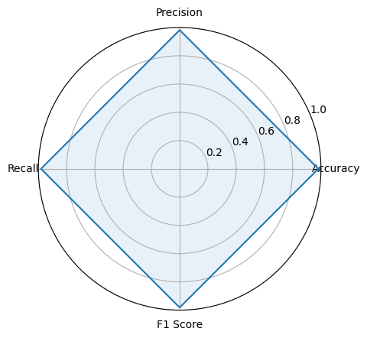
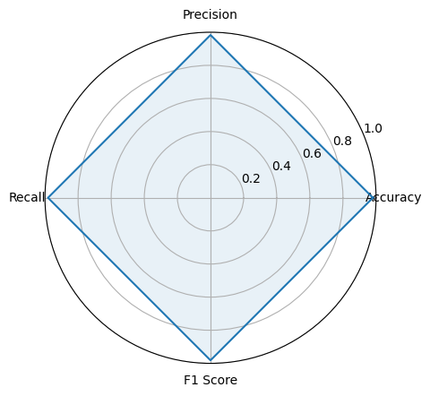









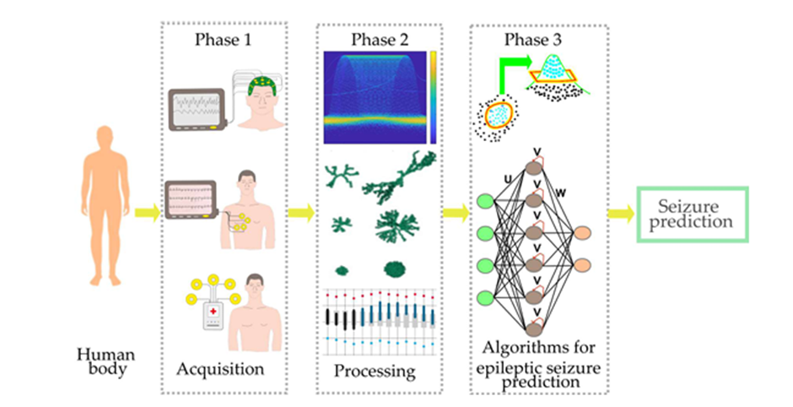
Wearable device for predicting Epileptic Seizures using AI
Computer Engineering - College of Computer
Abdullah Ghanim Alghanim ID: 431107765 Muhannad Saleh Alkhudhayer ID: 431107914
Harun Khalid Alagil ID: 431107905 Mohammad Saleh Alqernas ID: 421108241
Supervisor: Dr. Jamal Al-Otaibi
ABSTRACT
Epilepsy is a neurological disorder characterized by sudden and unpredictable seizures, creating serious risks to patient safety and making daily life difficult to manage due to the lack of reliable real-time prediction systems. This project proposes a wearable solution that analyzes EEG and physiological signals using signal processing, deep learning (CNN), and machine learning techniques to predict seizure onset in advance. The system provides timely warnings and notifies caregivers, enabling early intervention and improving patient safety and independence.
METHODOLOGY
EXPERIMENT
A hardware setup using MAX30102 (HR & SpO₂) and BMI160 (motion) sensors is connected to a Raspberry Pi 4. Sensor and EEG inputs are processed using two pre-trained models for real-time seizure prediction, achieving reliable performance with timely alerts and caregiver notification.
Data Acquisition:
EEG headband collects brain signals
Wrist sensor collects [HR,HRV,Spo2,Motion]
Processing:
Noise removal and filtering
Signal synchronization and segmentation
AI Model:
Preprocess EEG signals
Extract features using CNN
Apply Deep Learning and Machine Learning models
RESULTS
Prediction Using EEG Signal Model Performance
Physiological Signal-Based Detection Model Performance
Alert & Notification System:
Generate early warning
Notify patient and caregivers
Enable quick response
Instant Cloud Backup
Alert Patient
YES
Sensors
Processing
Unit
Seizure Detected
NO
CONCLUSION
Periodic Cloud Backup
Continue Monitoring
The system provides an effective solution for early seizure prediction using multi-sensor data and machine learning. Real-time alerts and caregiver notification improve patient safety and enable timely intervention. This approach supports more reliable and practical seizure management in wearable healthcare systems.

